Slide 1
The “Use of the Globes”
Mathematical Geography, the Mercantile Imagination, and Global Commerce in Postrevolutionary America
Tamara Plakins Thornton

Slide 2
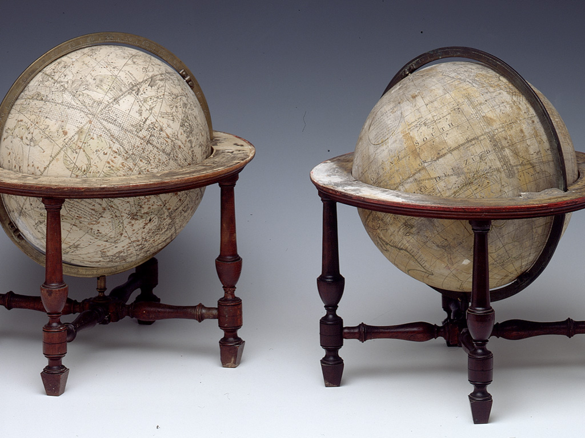
1. Celestial and terrestrial globes. Wm. Bardin and Gabriel Wright. London, 1783.

Slide 3
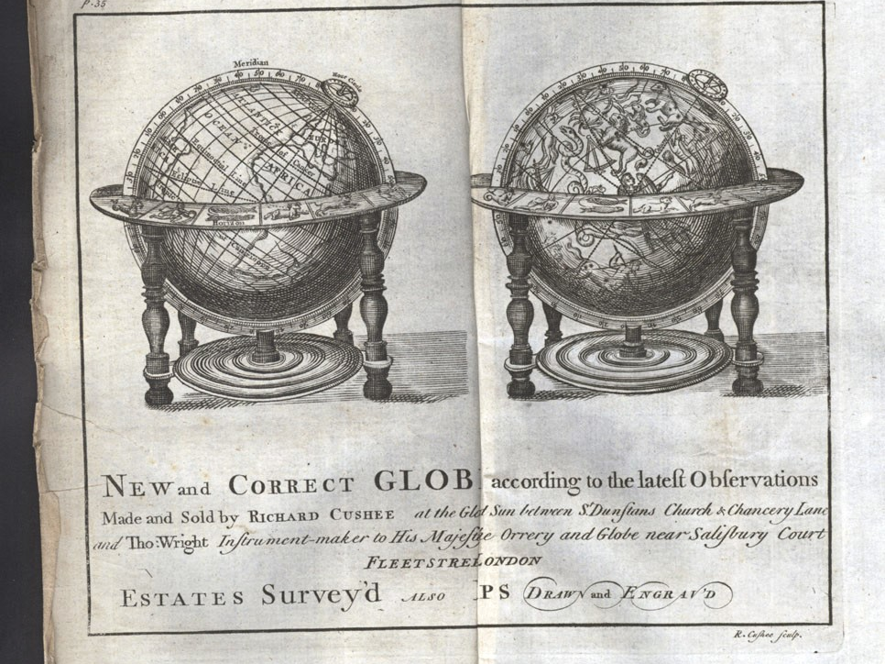
2. Joseph Harris, The Description and Use of the Globes (London, 1732).
The globes are encased in functional “appurtenances” designed for computations: the horizon ring, the meridian ring, the quadrant of altitude, the pointer or index, and the hour circle.

Slide 4
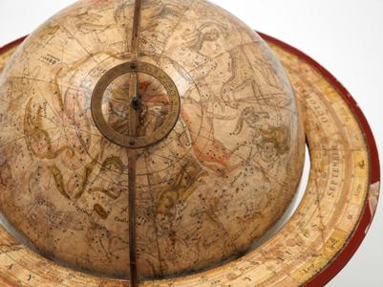
3. Celestial globe. John Senex. London, 1757.
A closer look at the globe’s functional, computational parts.

Slide 5
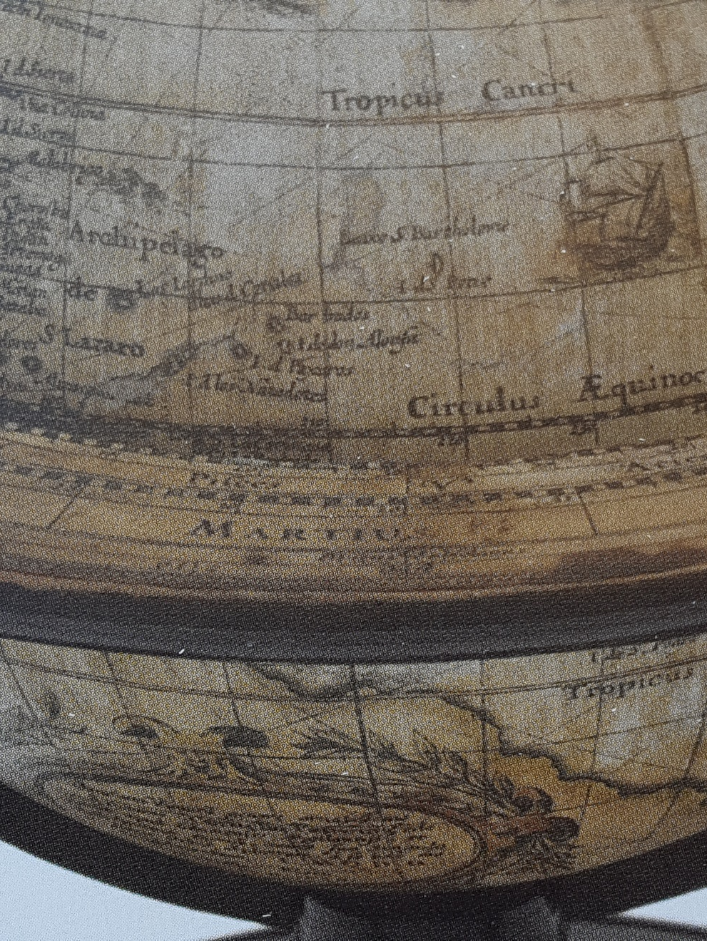
4. Horizon ring, Wright/Bardin terrestrial globe. London, 1783.
“Martius” (March); “Pisces”

Slide 6
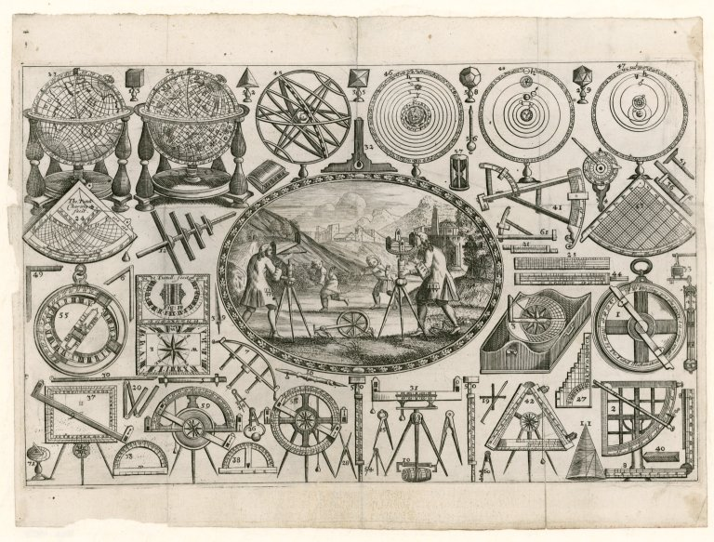
5. Trade card. Thomas Tuttell. London, early 18th century
Globes included among other precision instruments.

Slide 7
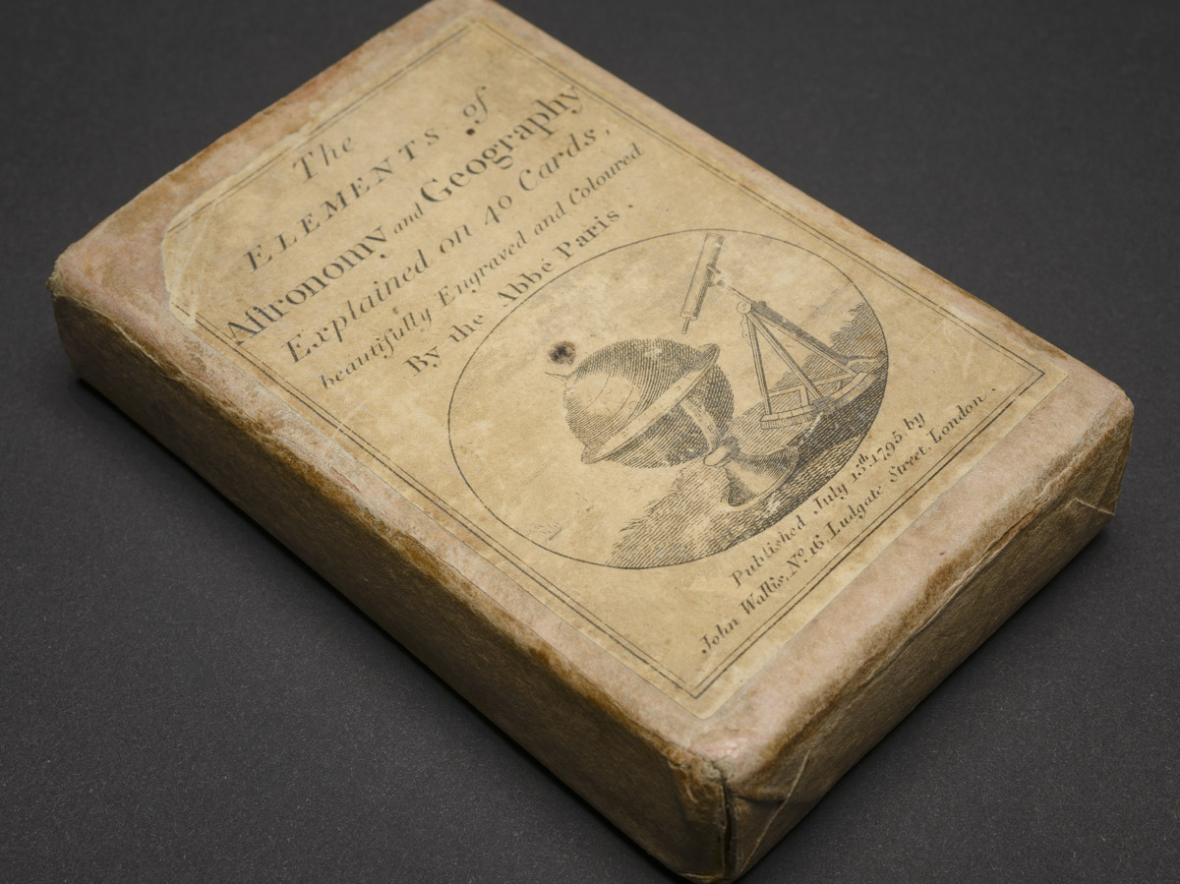
6. The Elements of Astronomy and Geography. London, 1795.

Slide 8
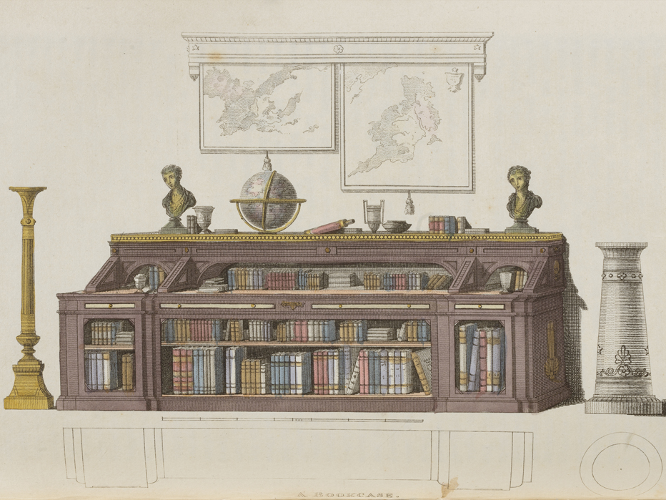
7. A gentleman’s library.
Ackermann’s Repository of Arts, Literature, Commerce, Manufactures, Fashions, and Politics. London, 1811

Slide 9
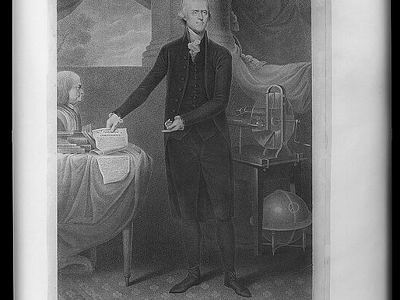
8. Portrait of Thomas Jefferson. Cornelius Tiebout. Philadelphia, 1801.

Slide 10
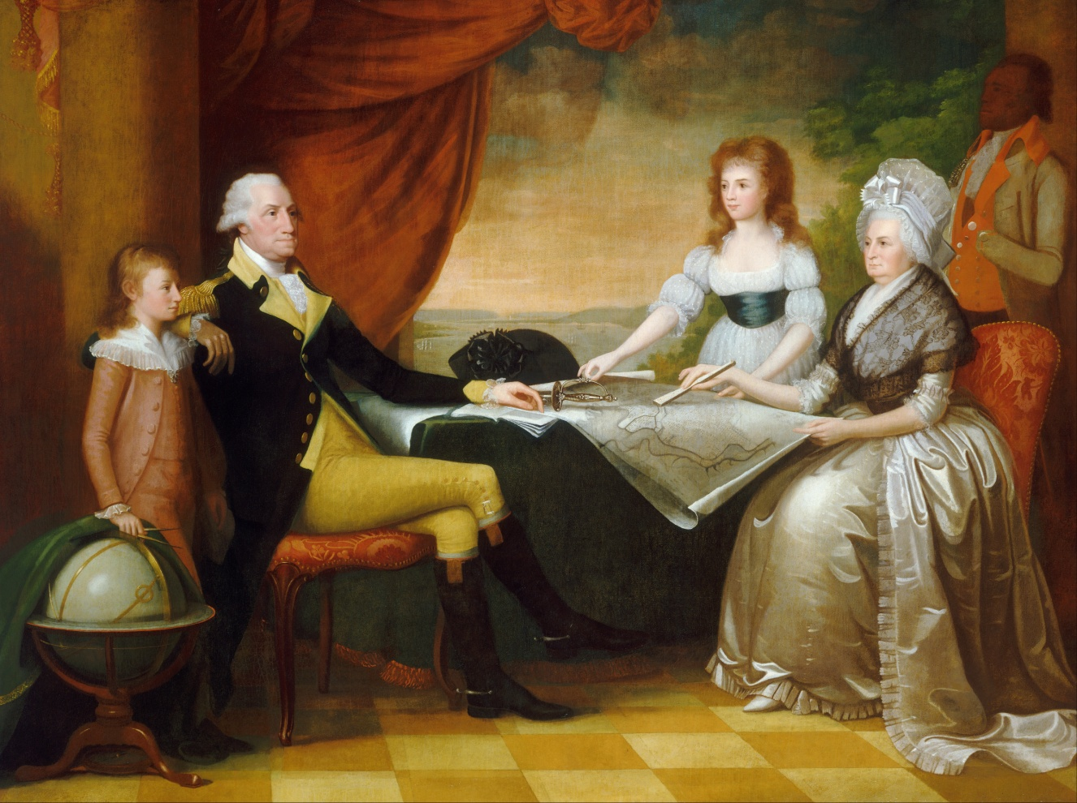
9. Edward Savage, The Washington Family. 1789-96.
In 1789, Washington wrote to London, ““I will thank you to send me by the first vessel, which sails for New York, a terrestrial globe of the largest dimensions and of the most accurate and approved kind now in use.”

Slide 11
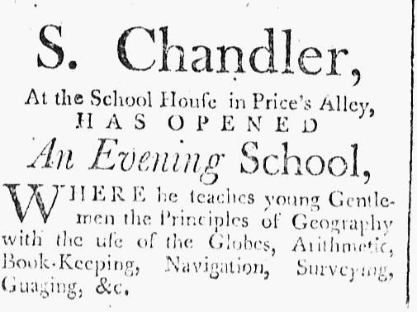
10. State Gazette of South Carolina, 22 October 1787.

Slide 12
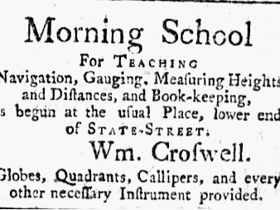
11. Independent Ledger (Boston), 14 June 1784.

Slide 13
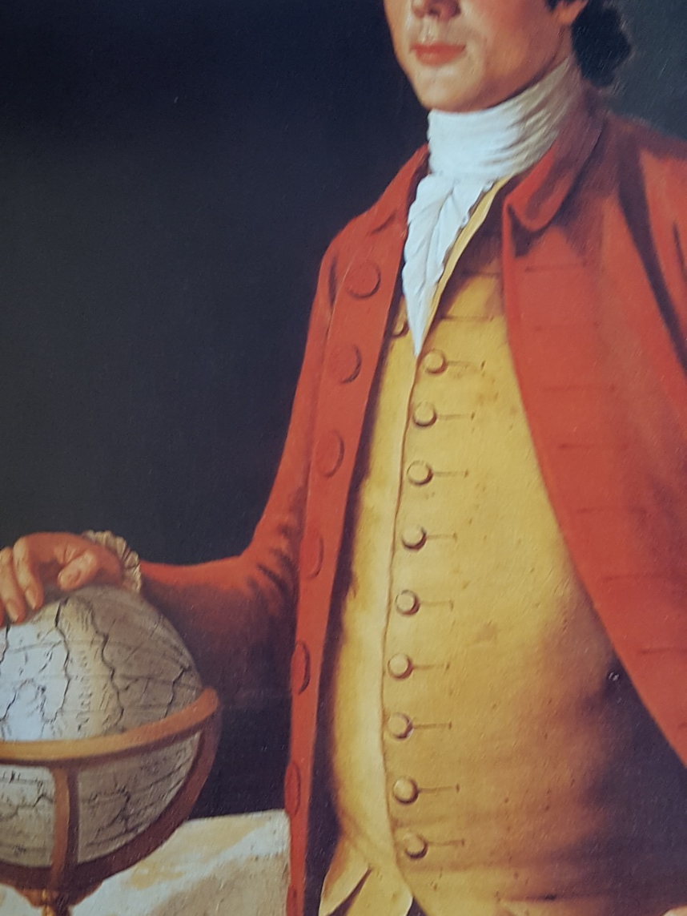
12. Benjamin Carpenter, Salem supercargo in the Indies trade. 1785.

Slide 14
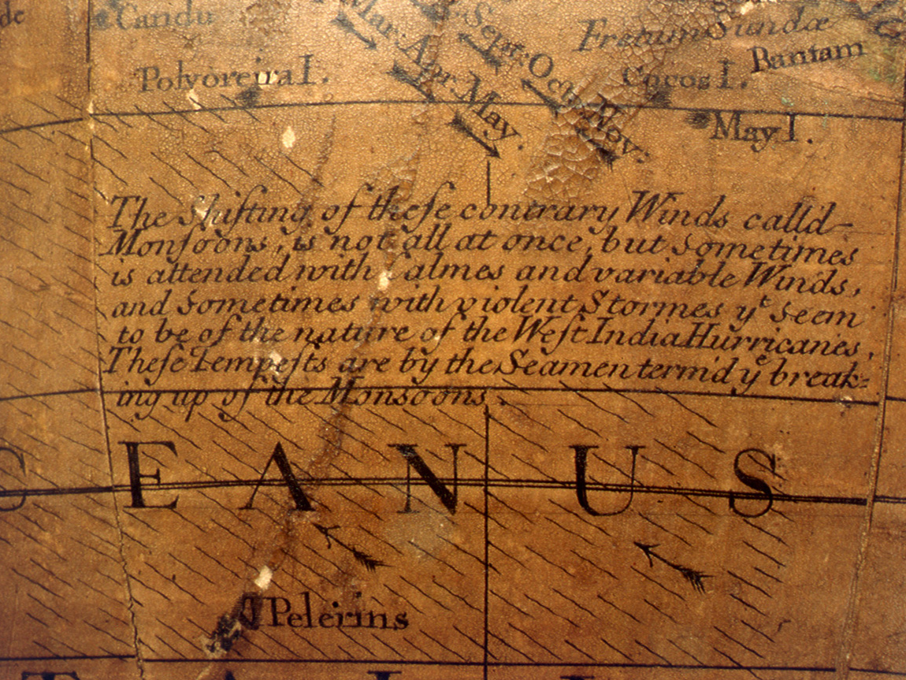
13. Detail of terrestrial globe. Charles Price. London, 1715.
Monsoons indicated by arrows.

Slide 15
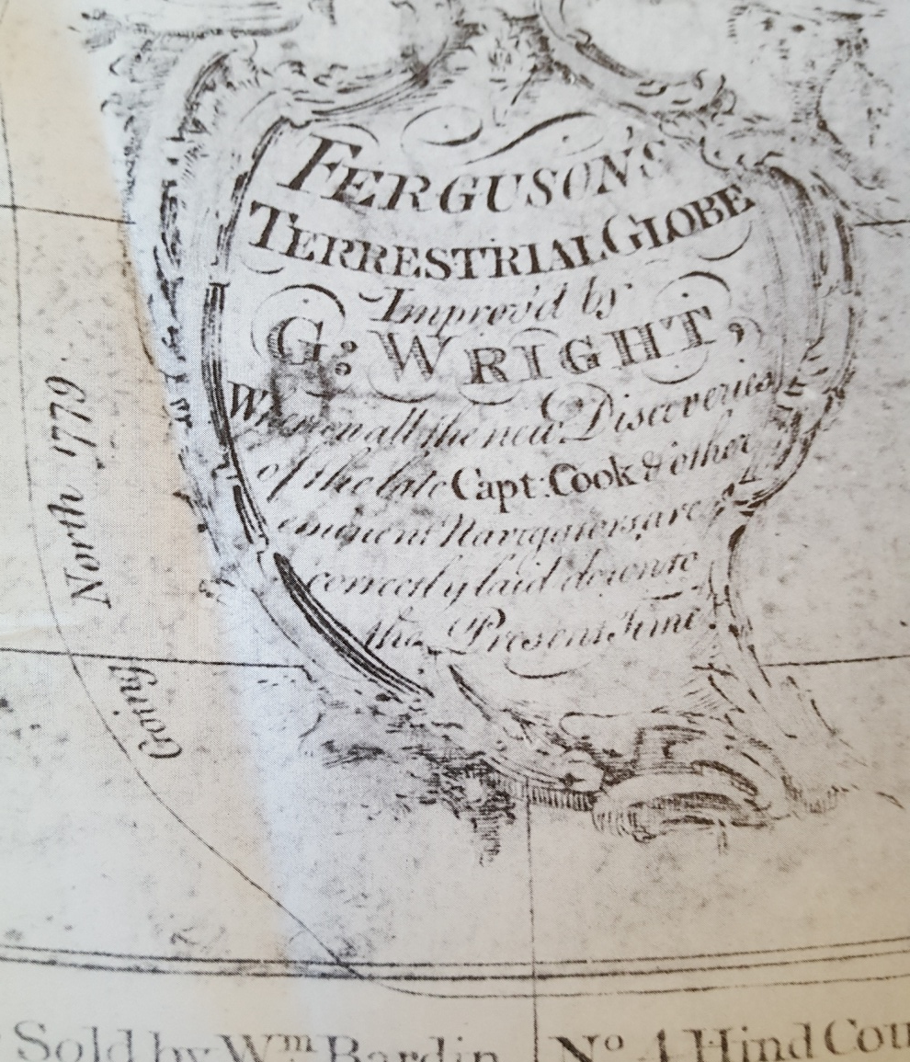
14. Ferguson’s Terrestrial Globe. London, 1782.
With “all the new Discoveries of the late Capt. Cook.” “Going North 1779” describes the track of Cook’s Discovery and Resolution after Cook’s death.

Slide 16
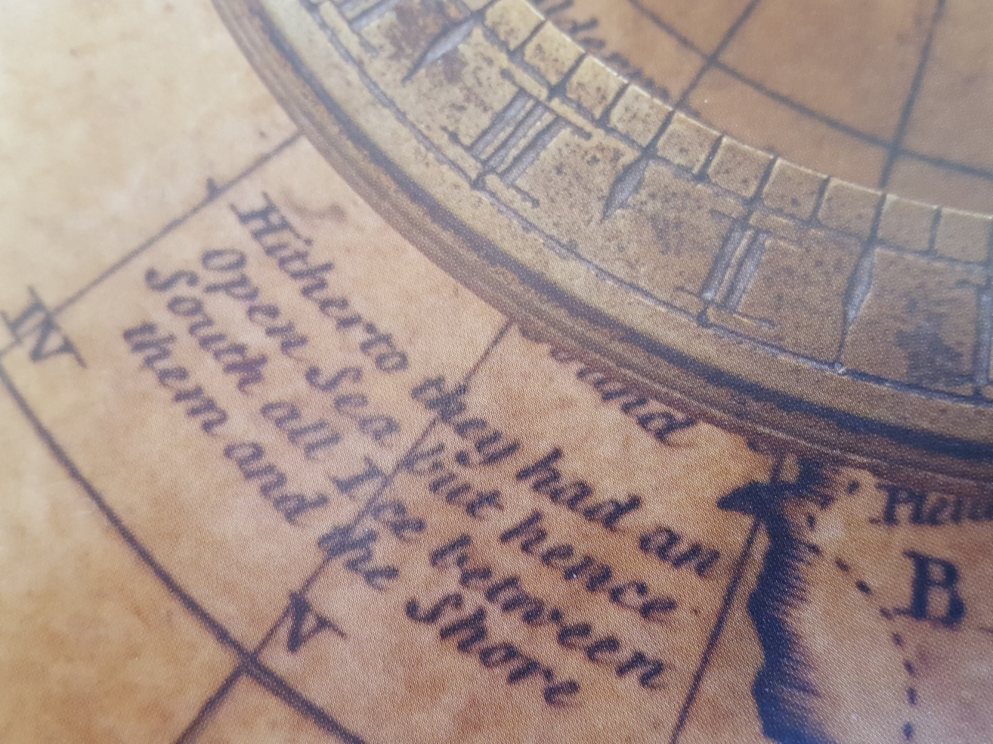
15. Terrestrial globe, John Senex and Benjamin Martin. London, 1757/1770.
Annotation of polar voyage.

Slide 17
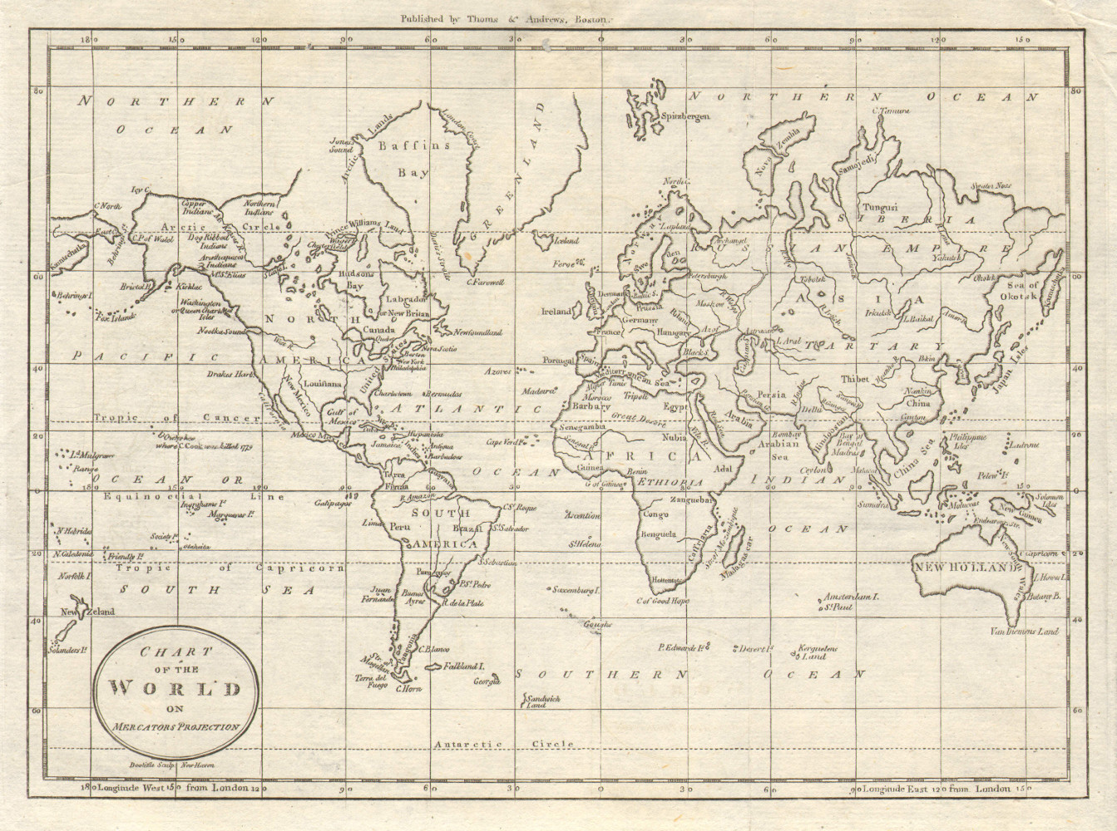
16. Mercator projection of the world, Morse’s Universal Geography (1793).

Slide 18
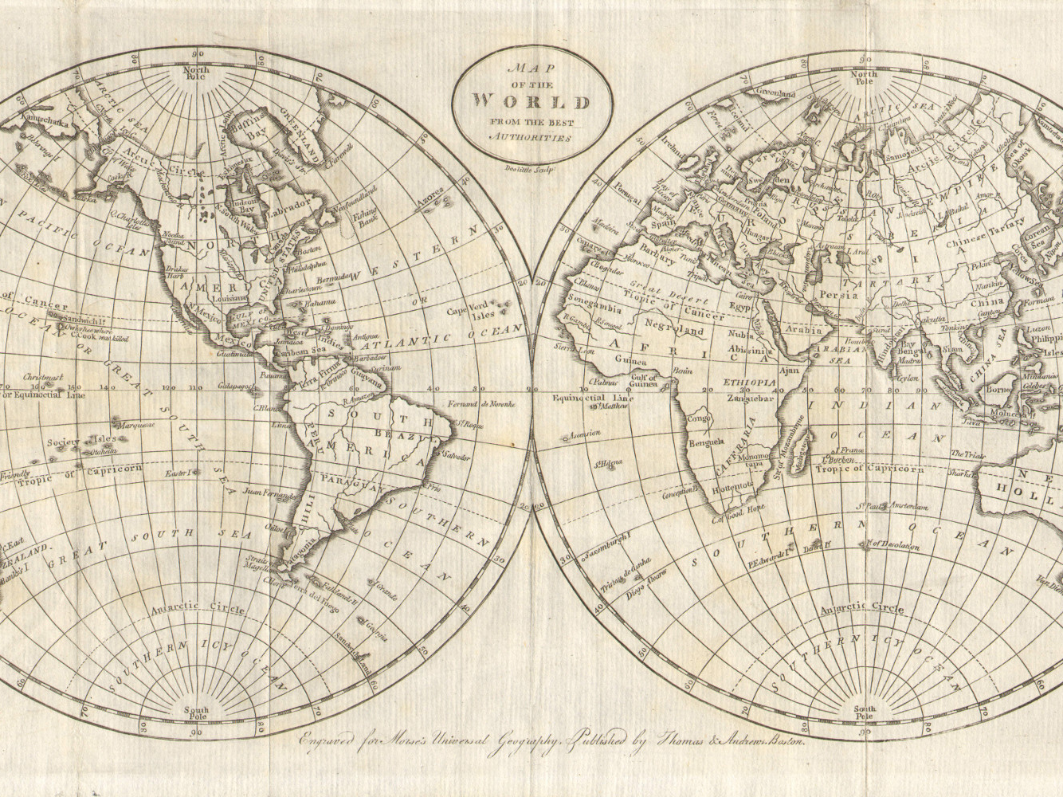
17. Hemispheric projection of the world, Morse’s Universal Geography (1793).

Slide 19
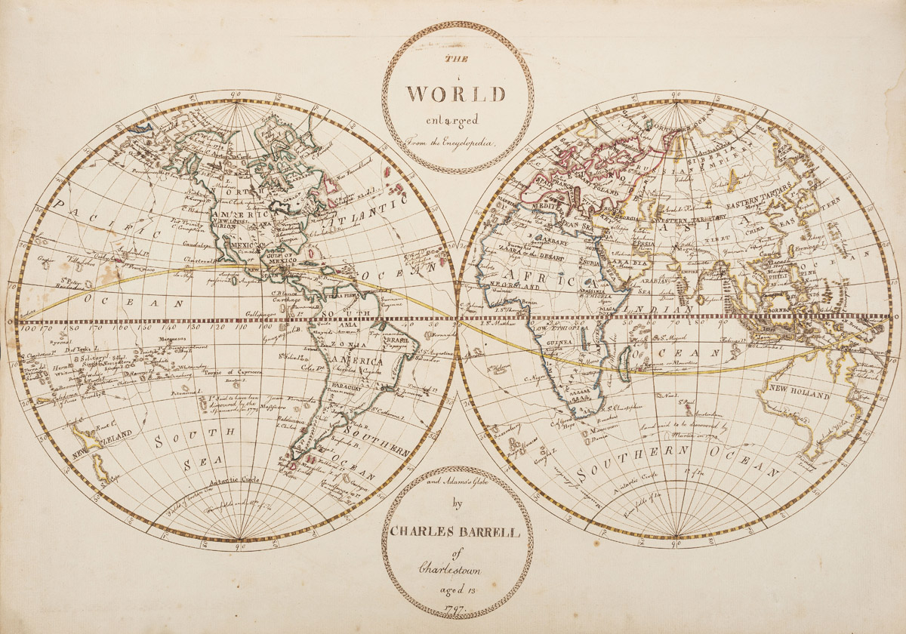
18. Charles Barrell, hemispheric projection of the world, 1797. Joseph Downs Collection, Winterthur Library.
“From the Encyclopedia and Adams’s Globe.”

Slide 20
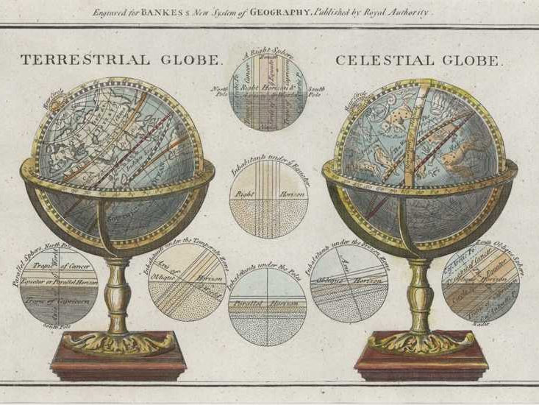
19. Bankes’s New System of Geography. London, 1787.
The circle diagrams between the globes concern the human inhabitants of the Earth’s temperate and frozen zones, and those living at the Equator and the Poles, providing the science of their shadows.

Slide 21
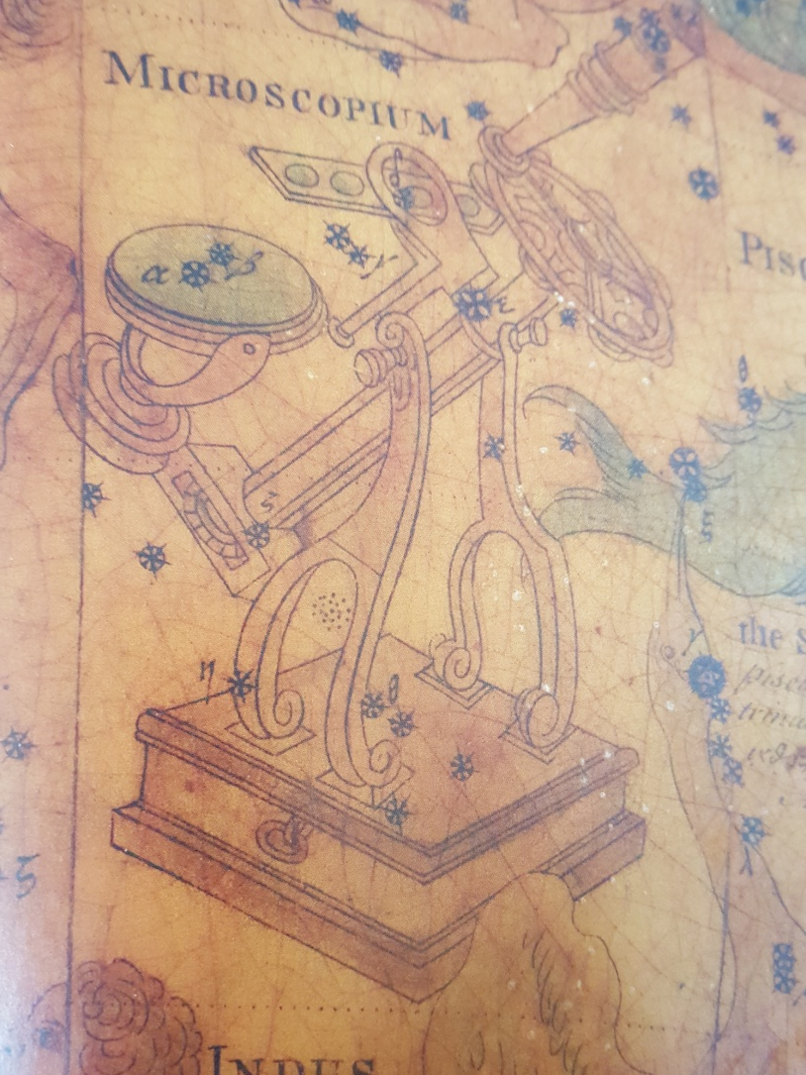
20. Detail of celestial globe. George Adams. London, 1772.
“Microscope” was one of the “Enlightenment” constellations added by astronomer Nicolas-Louis de Lacaille in a 1763 publication.

Slide 22
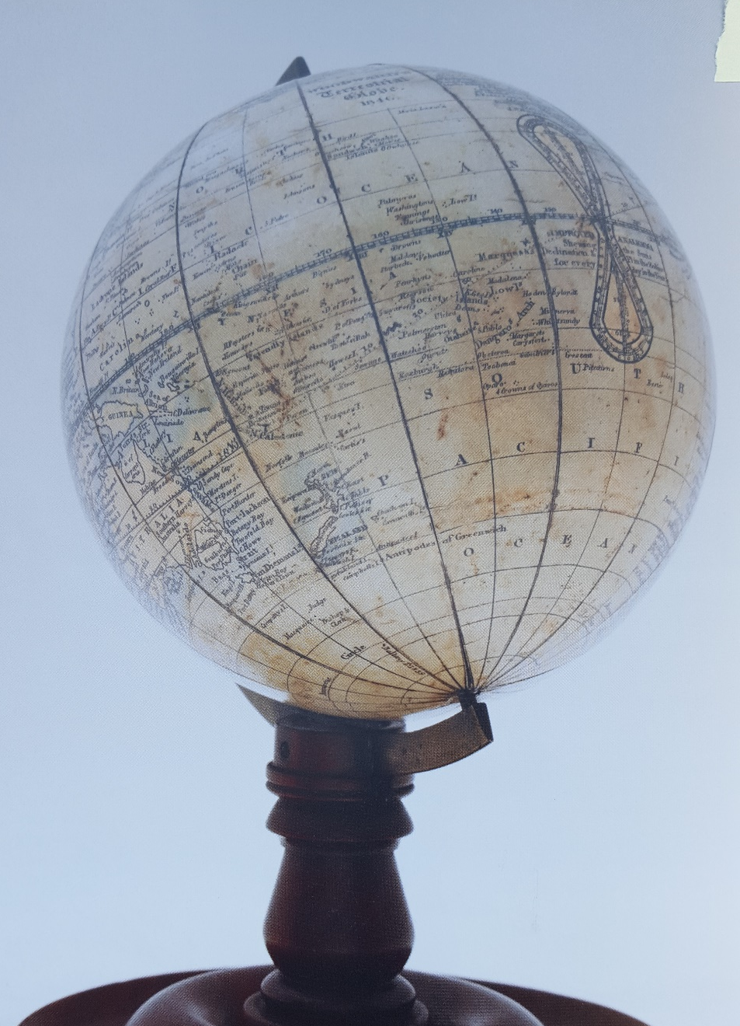
21. George Woodward. London, 1846. Earth suspended at a fixed angle in a semi-meridian ring on a single pillar. No horizon ring, adjustable meridian ring, quadrant of altitude, pointer.

